Slide 1
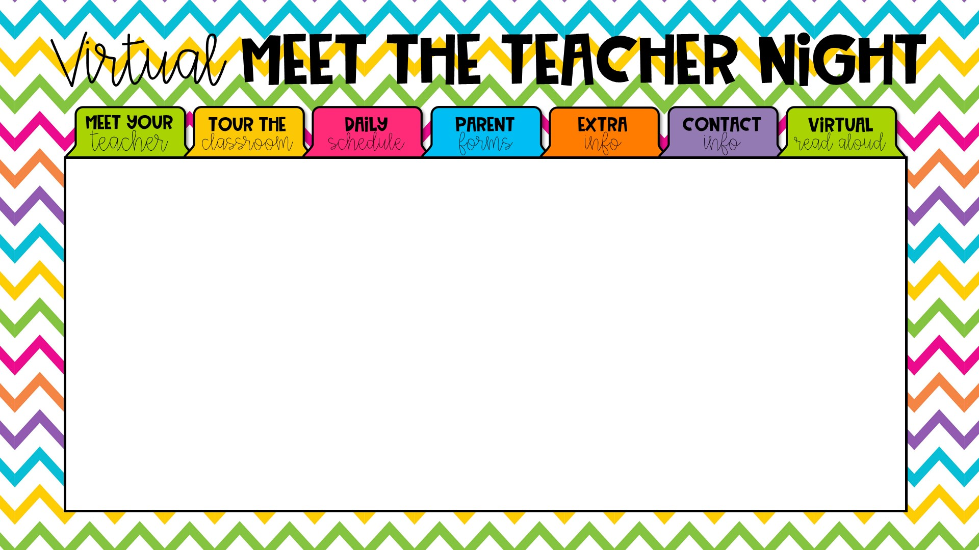
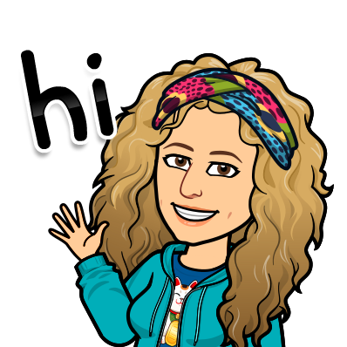
Dear Parents,
Since we are unable to have an “in person” orientation, I am bringing orientation to you! I want to start off by saying that I am very excited to have your child in my first grade class this year! It will be a year of magical wonder and amazing growth for your little star! While I wish we could be together in person, I have compiled the most important information for you, virtually.
I believe that communication is the key to your child’s success and to a great parent/teacher relationship. I encourage you to contact me if you have
any questions or concerns. I am looking forward to an
amazing year!
Love, Ms. Metcalf

Slide 2
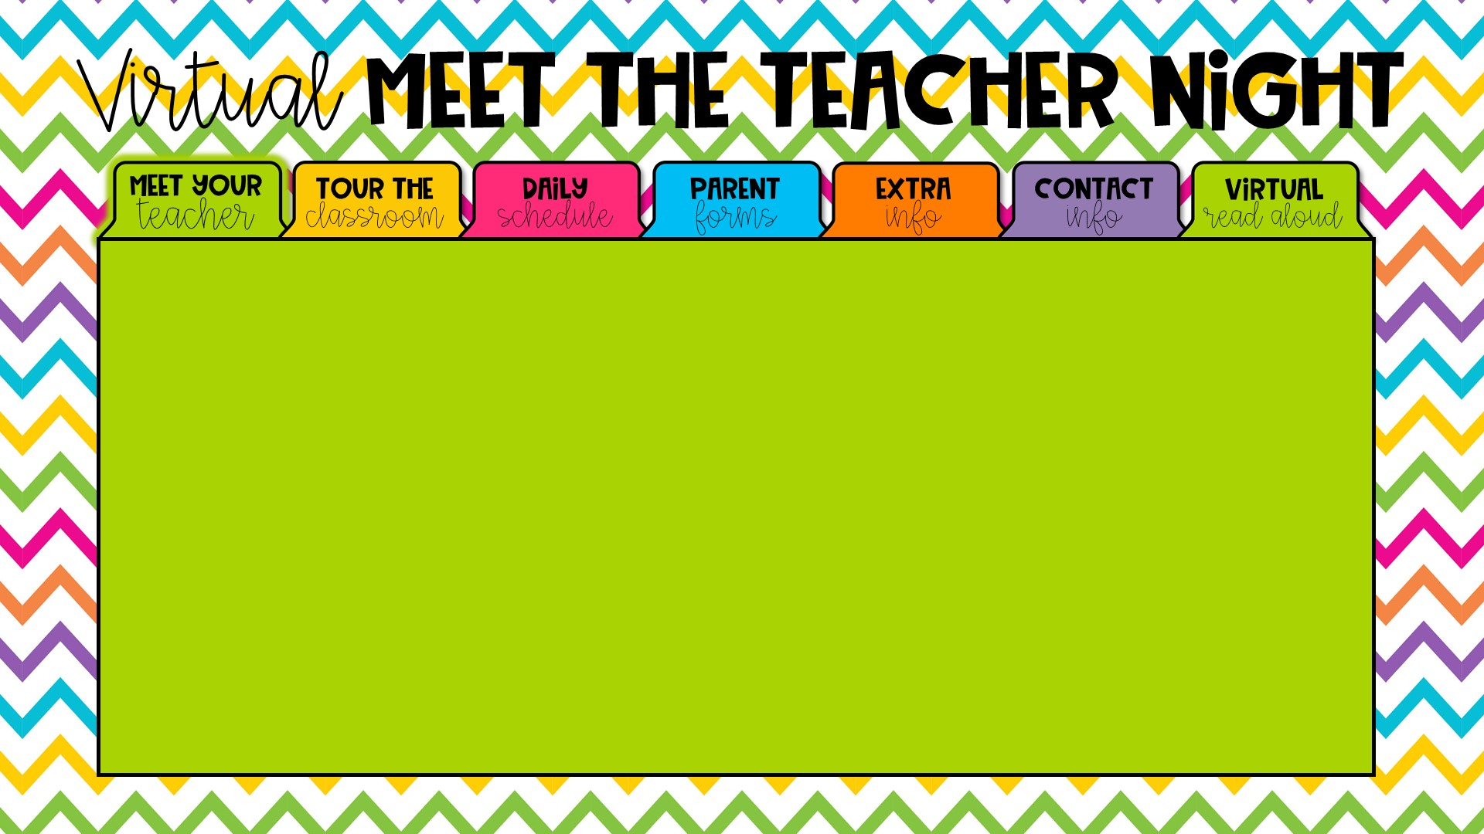
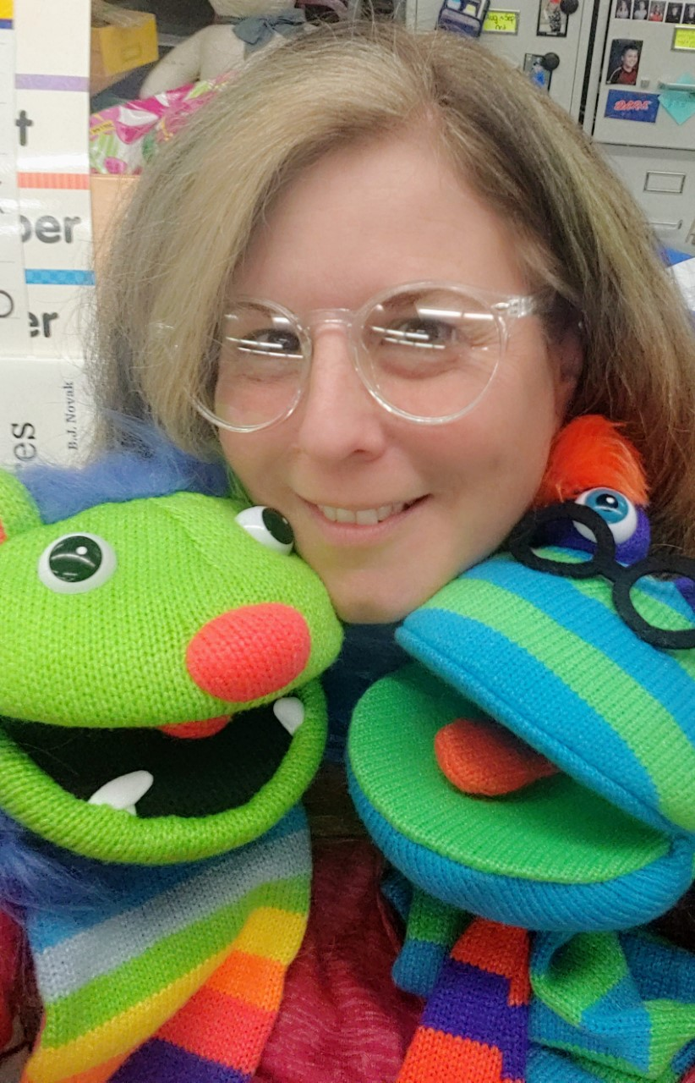

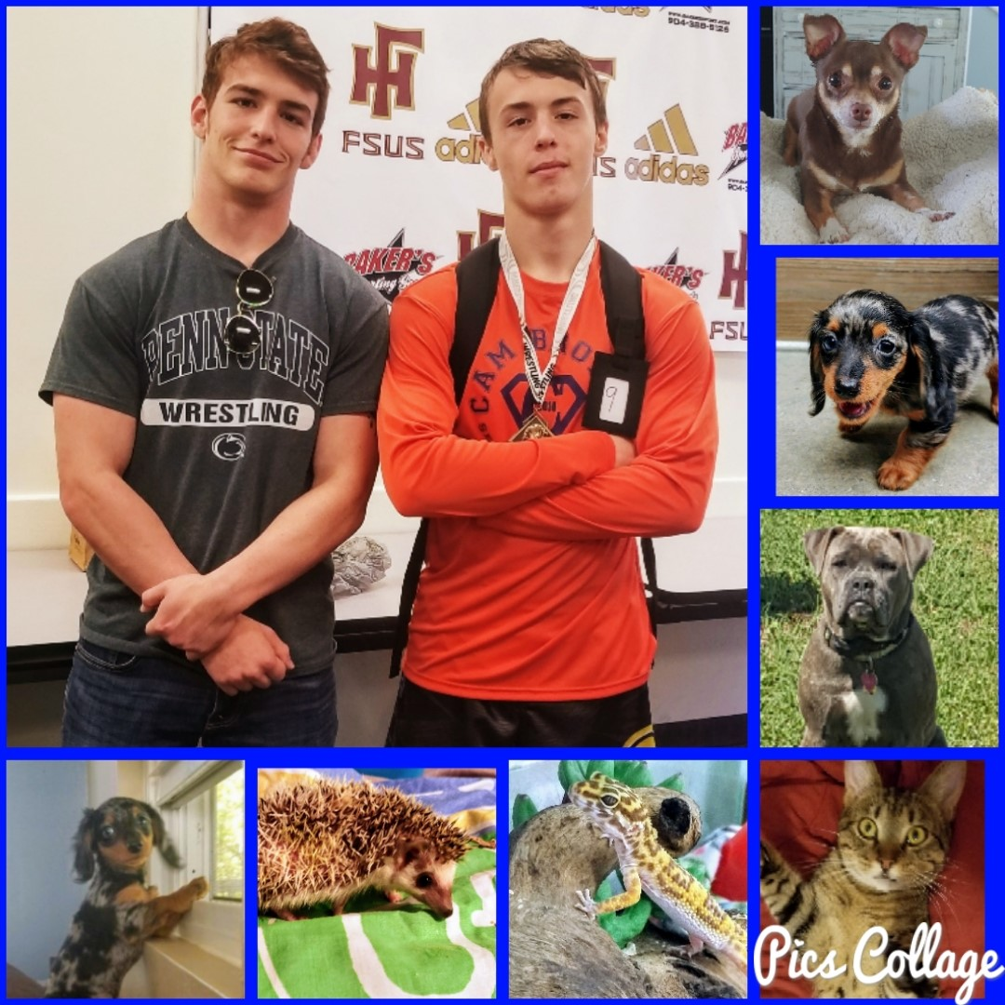
Hi! My name is Ms. Metcalf and this is my 29th year teaching at Fort Braden School.
I have two wonderful sons! Bryan is 20 and attends UCF and Max is 19 and is attending FSU. They both went to Fort Braden when they were little.
I am a huge animal lover! I have dogs, a cat, a hedgehog and a Leopard Gecko. I am hoping to get a goat sometime in the near future! I am also hoping that later in the school year, I will be able to have classroom pets, again.
My favorite hobbies include camping, hiking, cooking, watching movies and watching football. I also love to collect puppets and crazy hats!
I CANNOT WAIT TO GET TO KNOW ALL OF YOU!!!

Slide 3
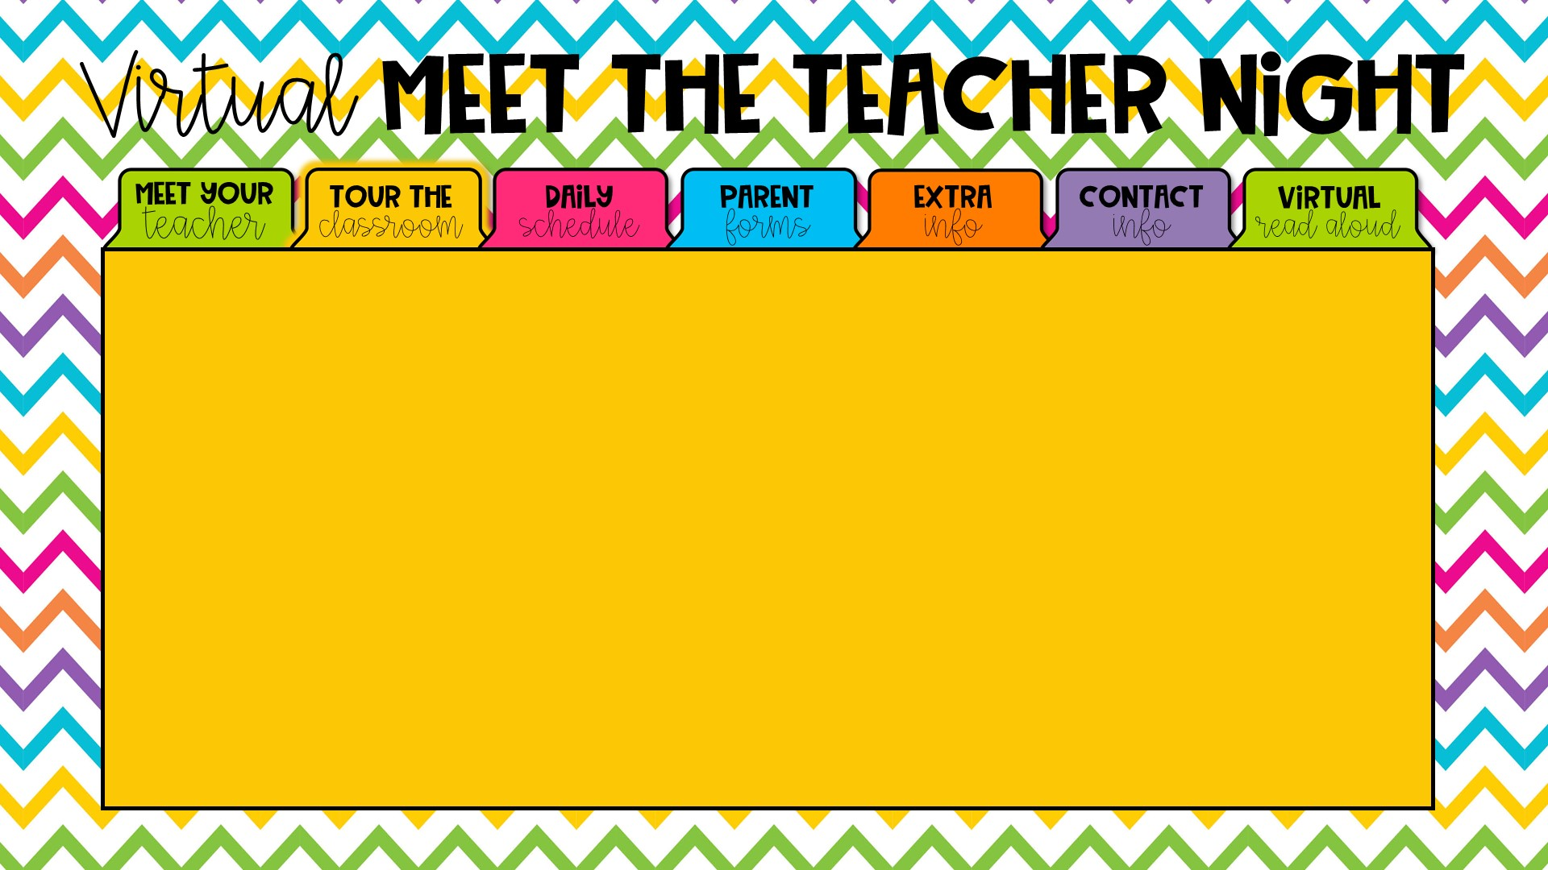

Since you will not be able to visit our classroom, before the first day of school, I have recorded a short video tour of our classroom for you - in two parts.
Intro to Virtual Classroom Tour
Classroom Tour

Slide 4
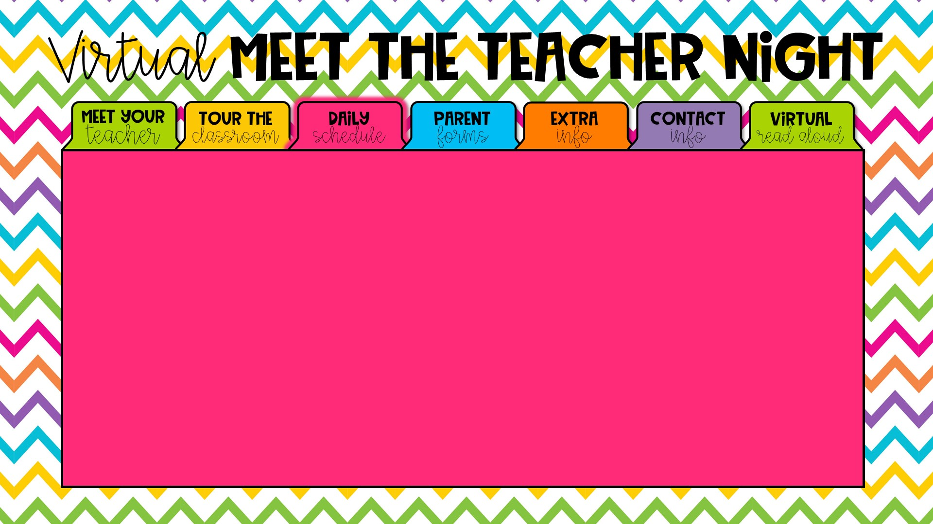
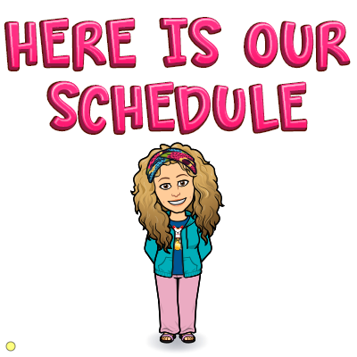
My class schedule is still a work in progress, but I will let you know the finalized times, as soon as everything is set. For my Digital Learning friends, I will be there every step of the way – to help make things as easy as possible. The first grade team will be pre-recording a lot of our lessons so that you can work, mostly, on your own schedule. We will have a daily “check in” time (to be announced) where our friends at home can see our friends in class and interact, virtually. I know that the process is still going on to get computers out to everyone. We are all in this together and we will figure it out, together.
For my students who will be with me, in person, things will look different than last year. Special Area will be coming into my classroom (except for PE) so that the students aren’t transitioning much. We will also be eating breakfast and lunch in the classroom. If you would like to pack a snack or send snacks in bulk (labeled with your child’s name), please do. As you know, wearing masks will be a requirement at school, but I plan on having mask breaks. When the weather is nice, I will take the students outside, at times, to do some academic activities (while distanced). I cannot say it enough, but please do not hesitate to contact me if you have any questions or concerns. Through the “Remind” app (which I mention under the “Contact Info” tab) you can reach me after hours.

Slide 5
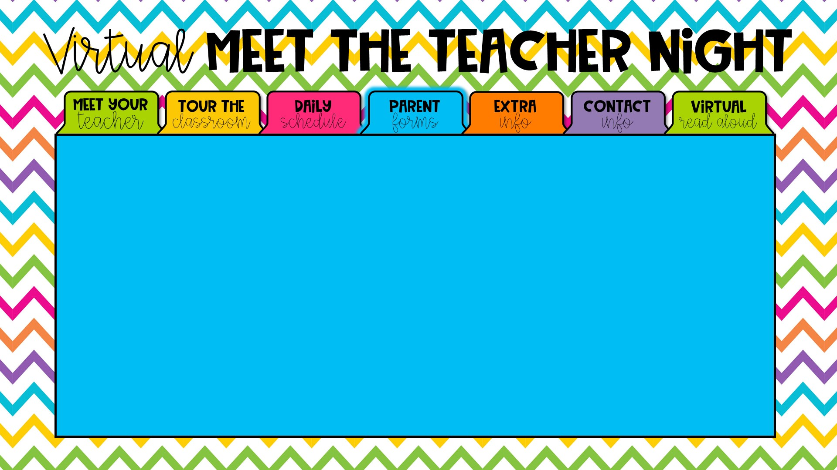

All required school forms are online, in your Parent Portal Focus account– which is on the Fort Braden website. Please try to log in and make sure that everything is complete. If you have any questions, please contact me and I will do my best to help you. If there is anything that I need you to fill out, I will let you know ahead of time and send it via the Remind app or through email.

Slide 6
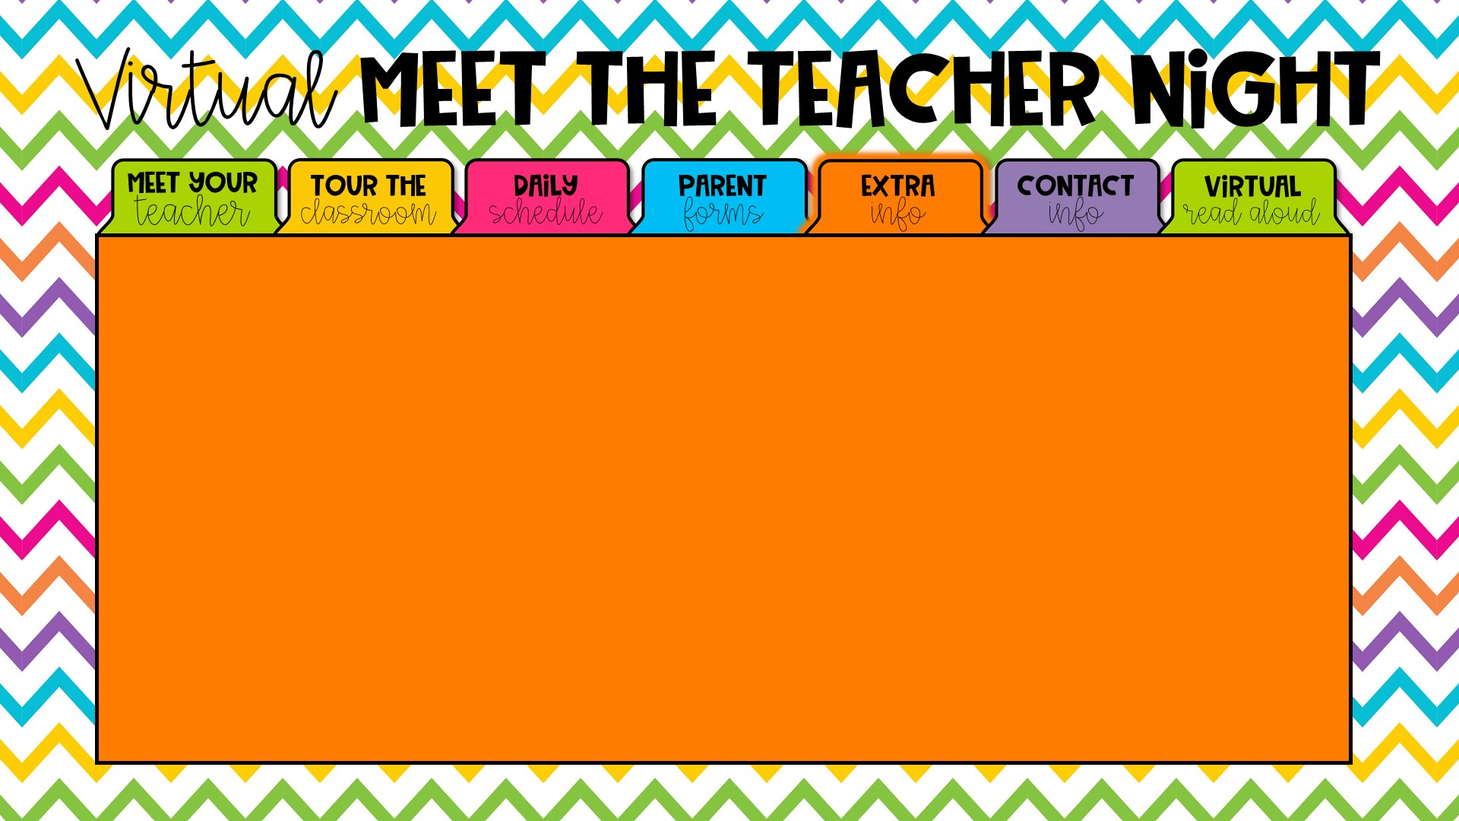
TITLE I at Fort Braden – What is it?
Leon County Title I Program receives Federal funds to provide supplemental instruction to students of public schools, neglected or delinquent sites, non-public schools, and homeless children. Services are provided for all students school-wide at Fort Braden. All K-8 Title I schools have 60% or more of their students on free or reduced lunch as determined by an Annual Economic Survey. Services are also provided to all students at eligible, neglected, or delinquent sites including Capital City Youth Services, Father Flanagan's Boys and Girl's Town of North Florida, Florida Baptist Children's Home, Homeless, Disc Village/ADT, Leon County Detention Center, Leon County Jail, PACE Center for Girls, Devereux Residential Center, Tallahassee Marine Institute, and LCS Ghazvini Transition Center.
Leon County Title I school plans are written by individual school sites and are directly correlated to the School Improvement Plan.
Schools in Leon County use Title I funds to support federal, state and local goals reflected in individual school plans. Teachers, parents, administrators, students, and all stakeholders are involved in the development and implementation of each school's plan. A strong parental involvement component is integrated throughout the plan at each site and each school utilizes a Parent, Student and Teacher Compact.

Slide 7
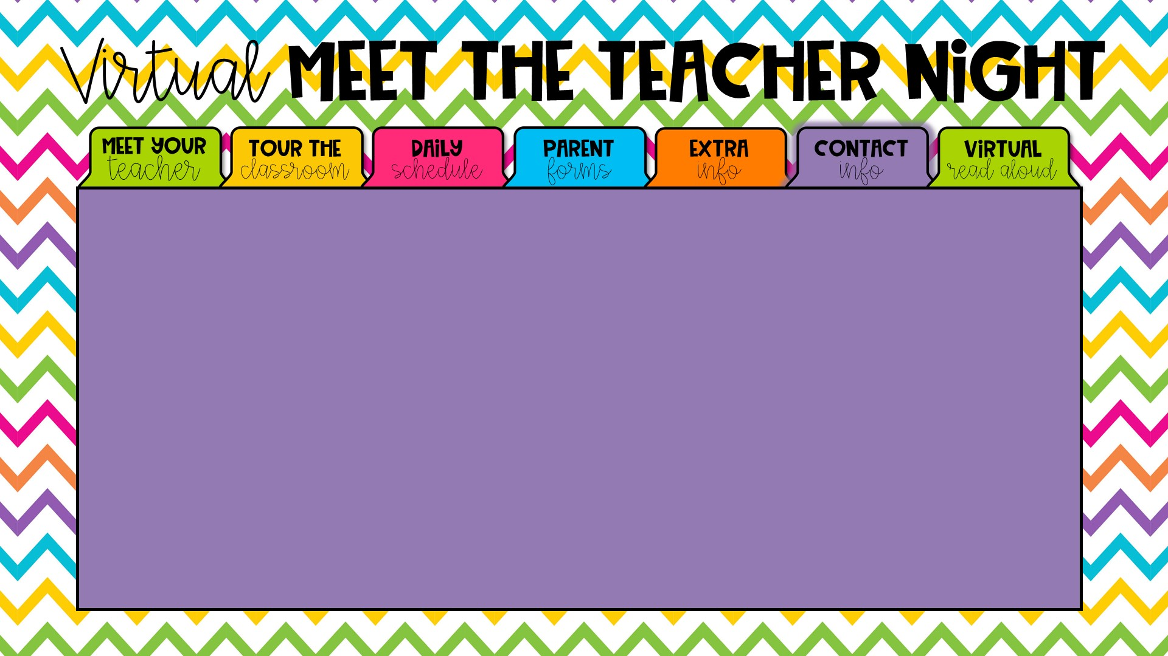
The school phone number is 488-9374. My planning time is from 10:00 – 10:40 and this is typically the best time for you to reach me, during the day. If you leave a message with the front office, I will get back to you as soon as possible. You can also email me at metcalfj@leonschools.net
Another great way to contact me is through an app called Remind. I am encouraging you to sign up; it is a wonderful tool for us to communicate back and forth. I can text you the information to sign up or you can go to
https://www.remind.com/join/4gb8cg

Slide 8
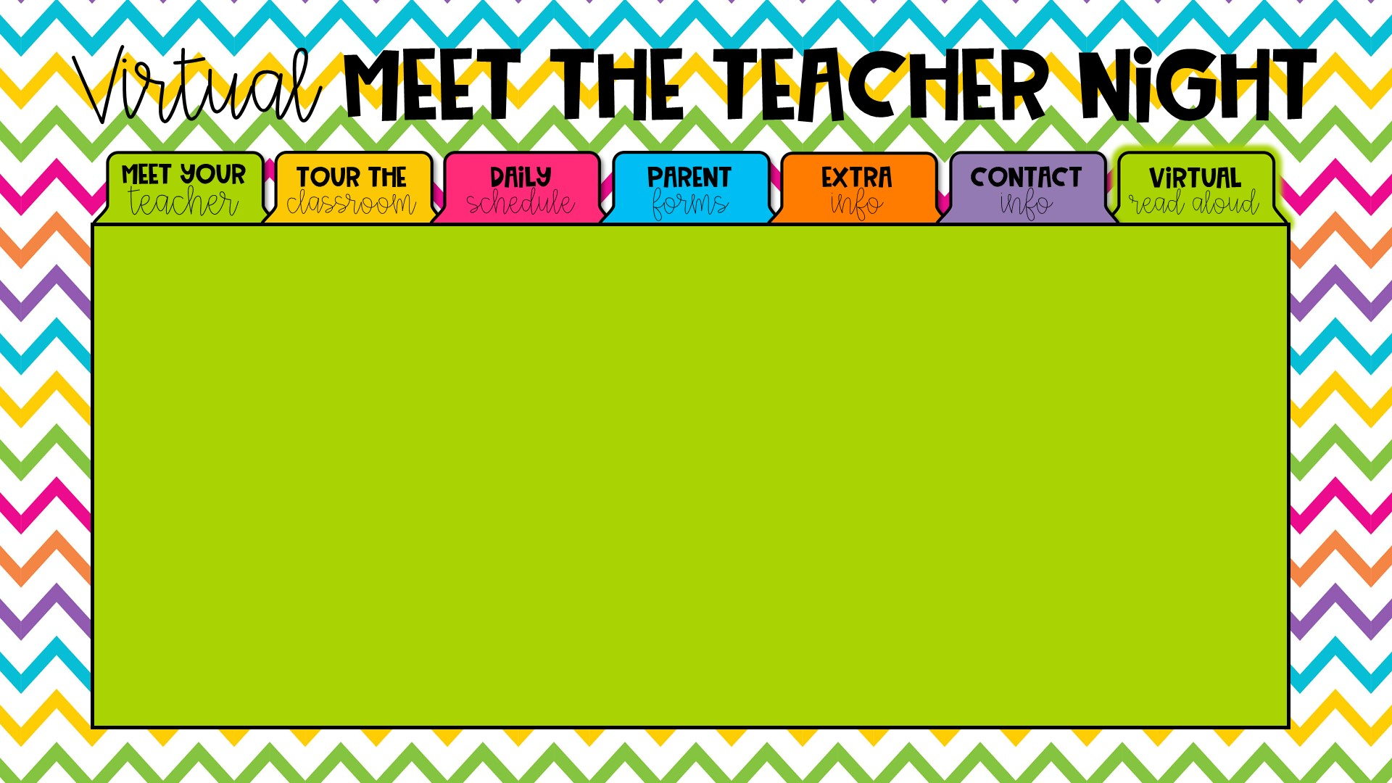

I love to read and I hope that you will share my excitement of books! Here is one of my favorite books for you!
https://youtu.be/LIG2OAOhO7A

